Slide 1

Log in to PLM
Before you log in:
2. Security Context
To use PLM, you need a Security Context that grants you creation rights in PLM based on your role and the project you are working on.
For creating the expected prototypes, you need a “PiloteProjet” role, a “PSA” organization, and the project you are required to work on.
- You can only use one Security Context per project (if you change project = you change Security Context).
For contractors, your STELLANTIS client is the one who makes the request.
To request a Security Context for yourself or for a colleague, connect to:
PSA role
Organization
Project
PLM access requests must be made in
PLMPassport

Slide 2
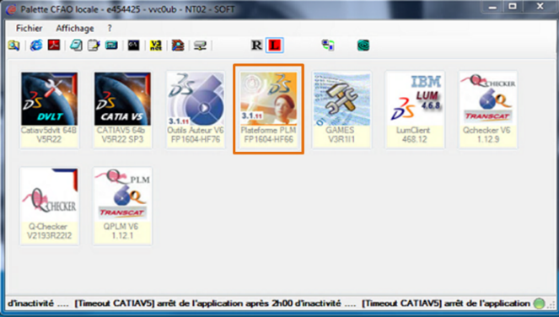
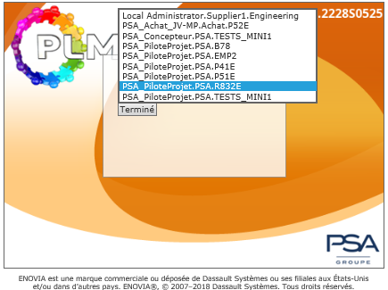
Log in to PLM
How to connect?
  Access:
    From the PLM icon in the CFAO palette on psa.com/
    or directly via the intranet address
    http://plm.inetpsa.com/enovia/common/emxNavigator.jsp

Slide 3
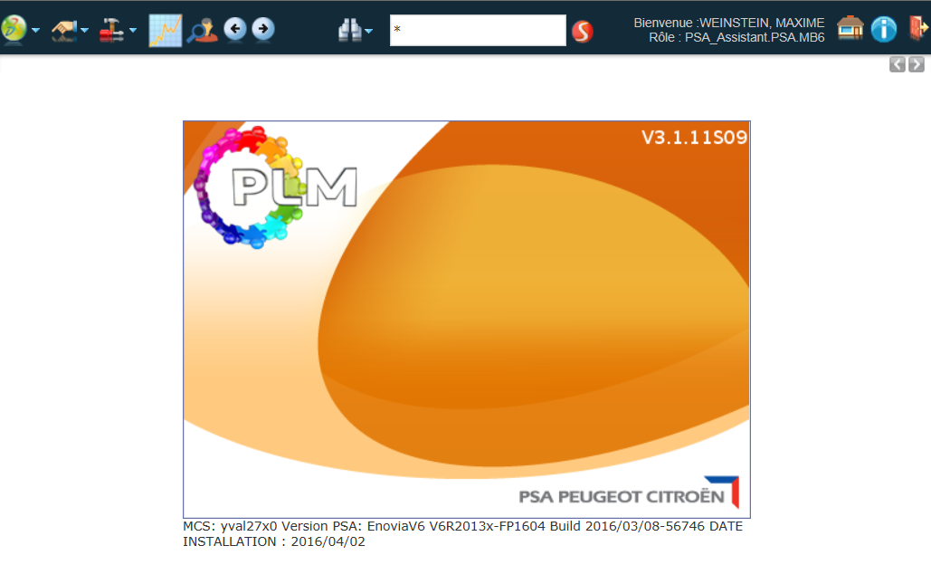


Log in to PLM
“items” in the menu bar
Actions
Tools
PLM Indicators Portal
Return to the home page
Exit PLM
B
My Enovia
A
Previous/Next page
C
Toolbar
Search tools
Home page
Do not use the browser's back/forward buttons

